Slide 1
Probe Mount LLC
LLC and LLB, Do in order of map, if there is only one FI, give the full name. Also do this if they are far apart in the crystal
When there is a cluster Penny has labeled it region. Name it reg1, reg2 etc
Don’t do multiple spots, just do one spot per FI.
If there is zoning, take BSE picture.

Slide 2
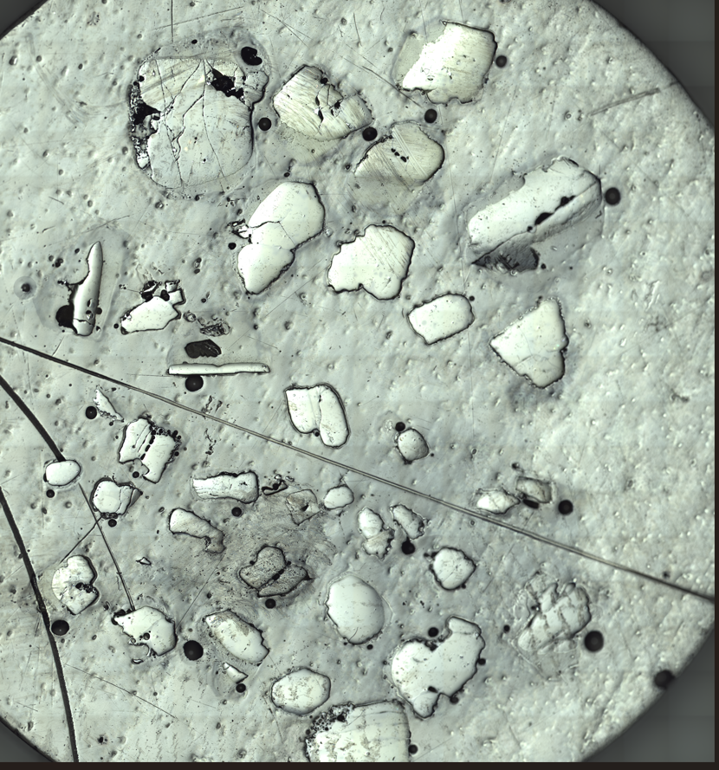
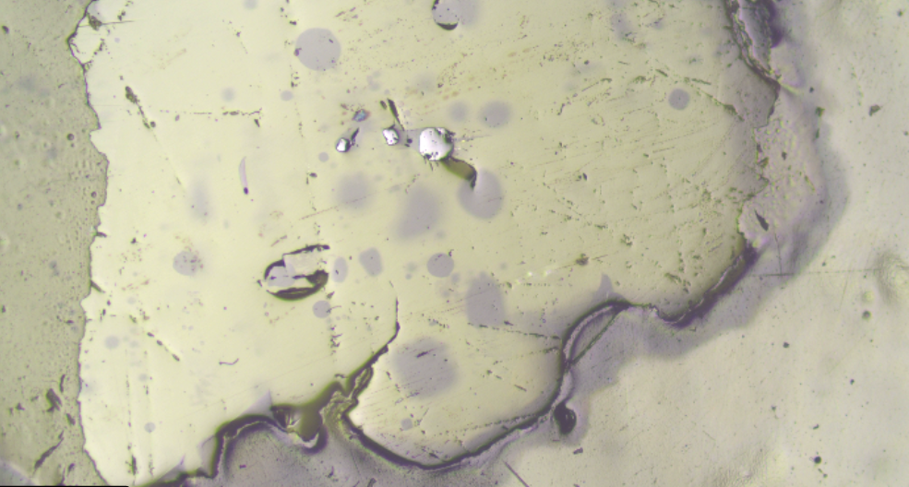
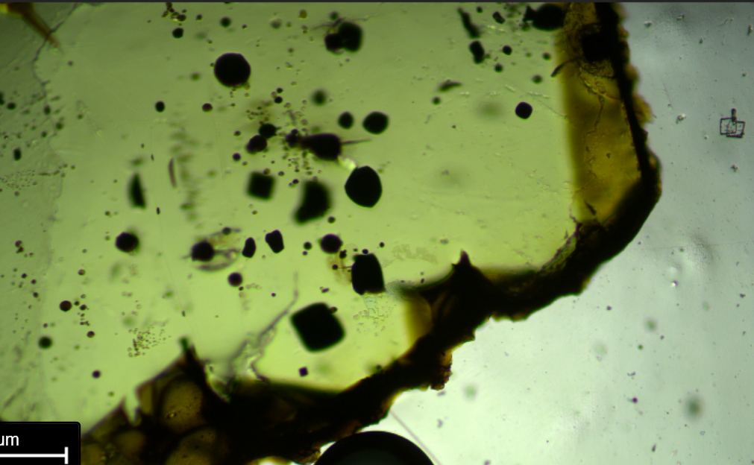
MLP_3_FIA

Slide 3
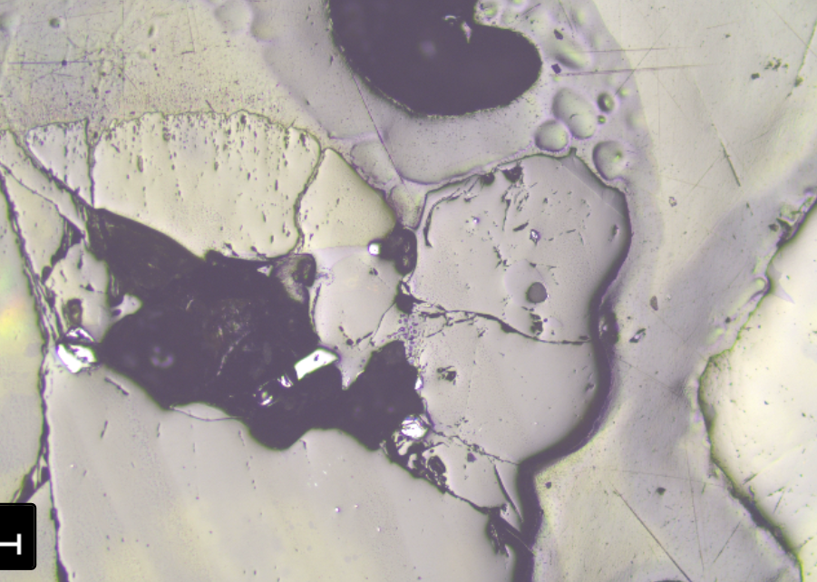
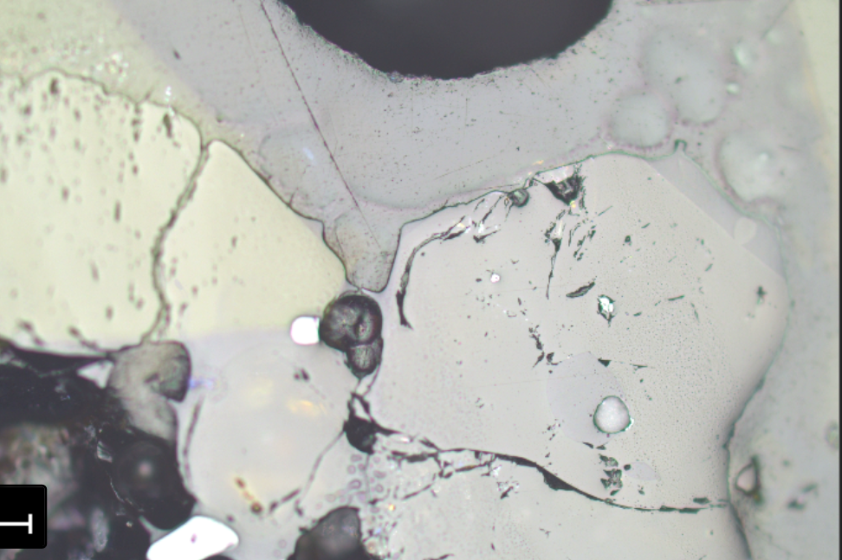
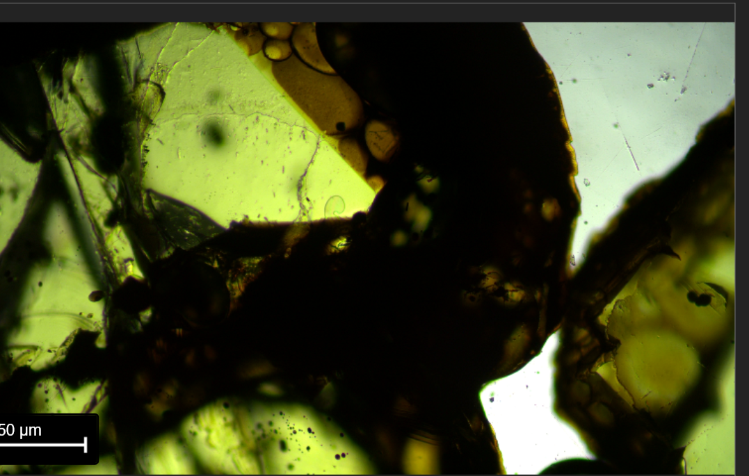
MLP_9
Do 2 points as small xstal
Penny use Fo for both A and B

Slide 4
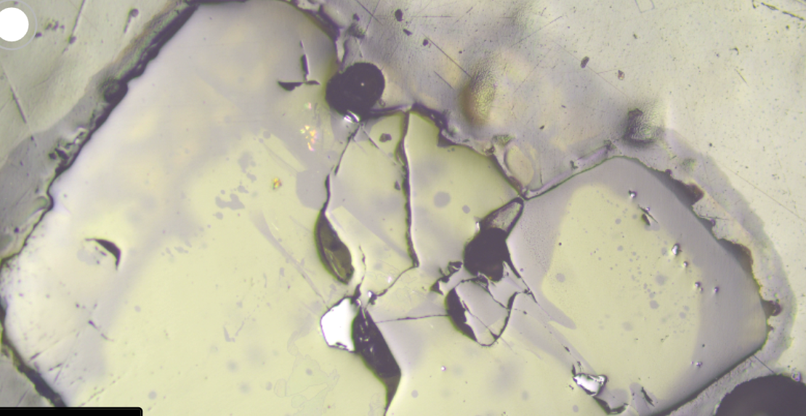
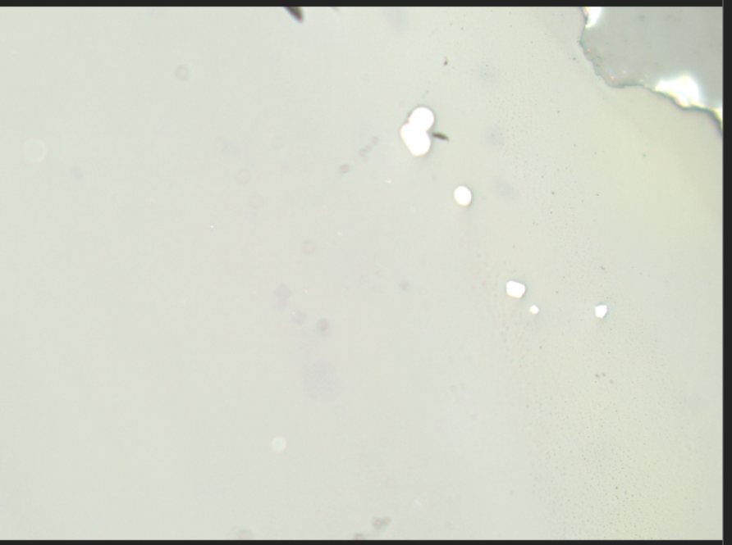
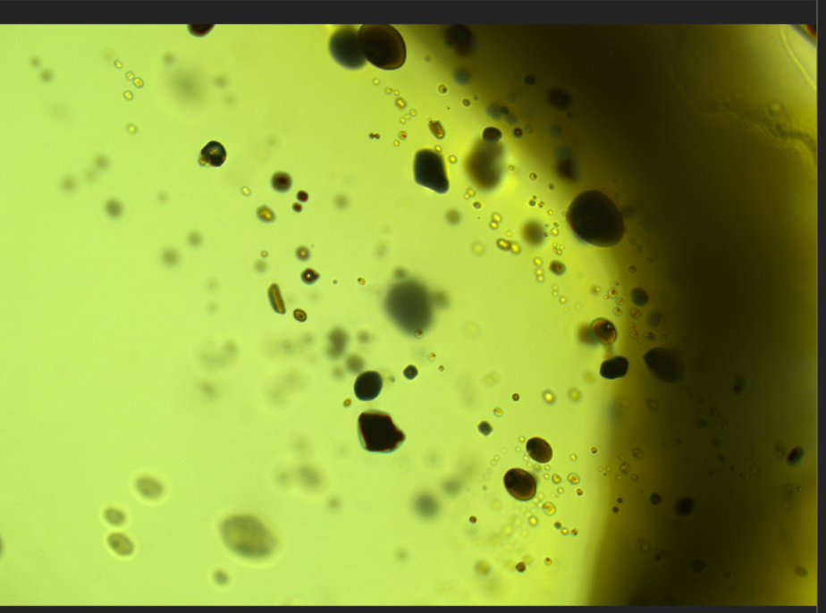
MLP_5_reg1
Penny
Same Fo for C and D

Slide 5
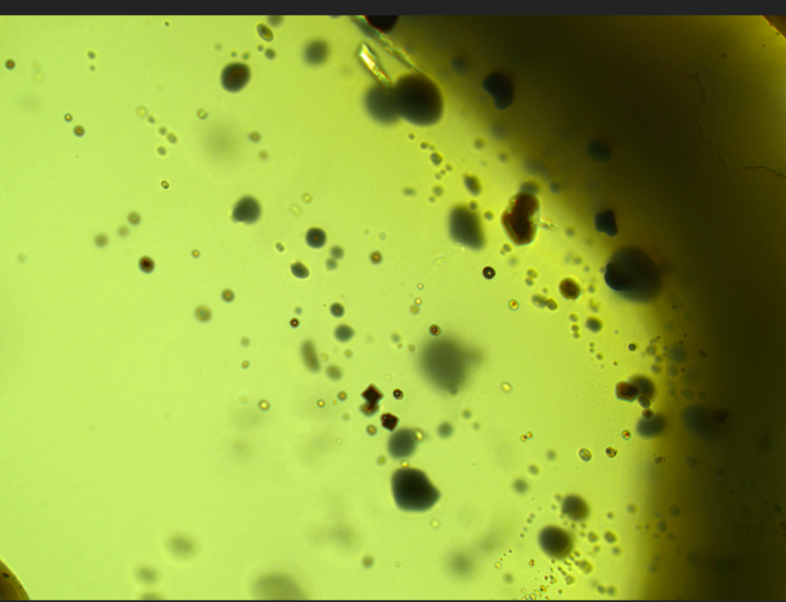
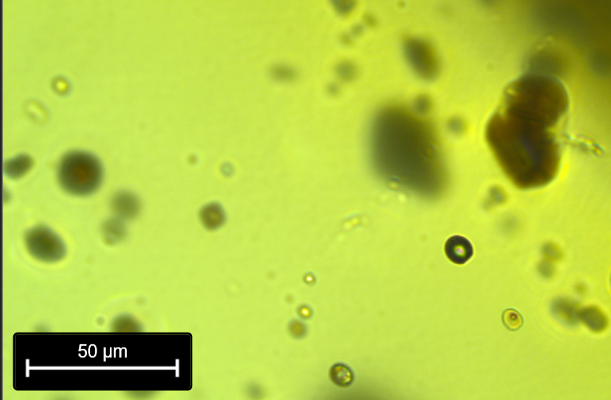
MLP_5_FIE
Penny
Ramaned 14th

Slide 6
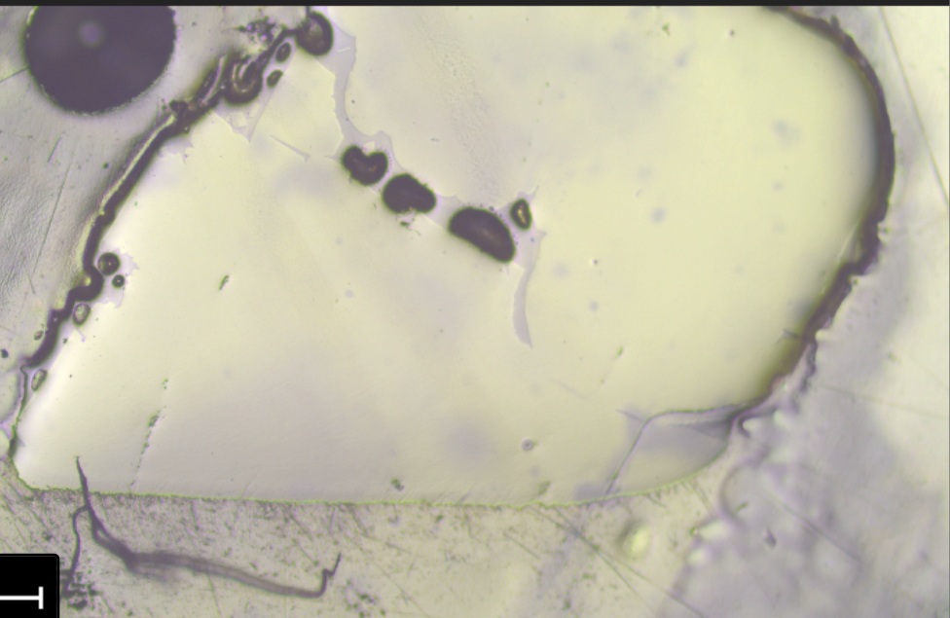
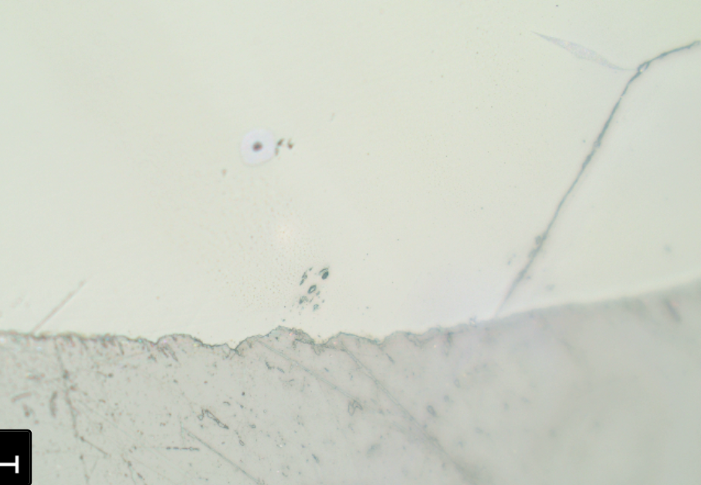
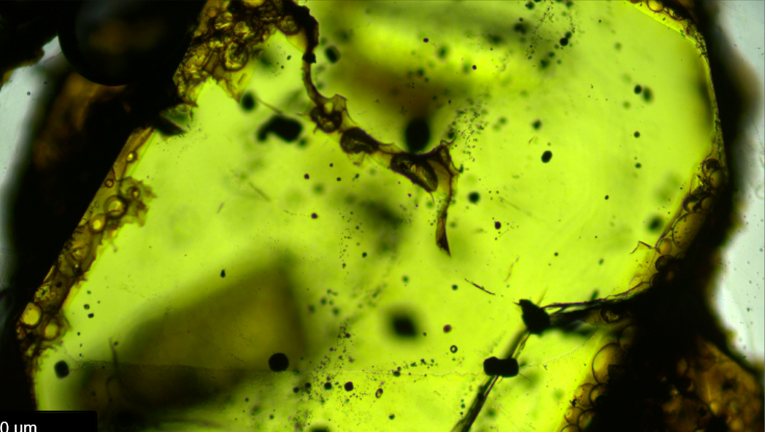
MLP_7_FIA

Slide 7
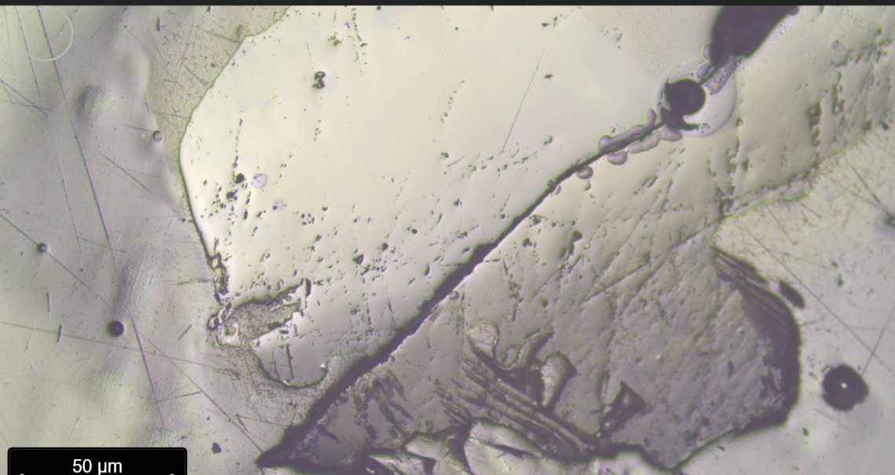
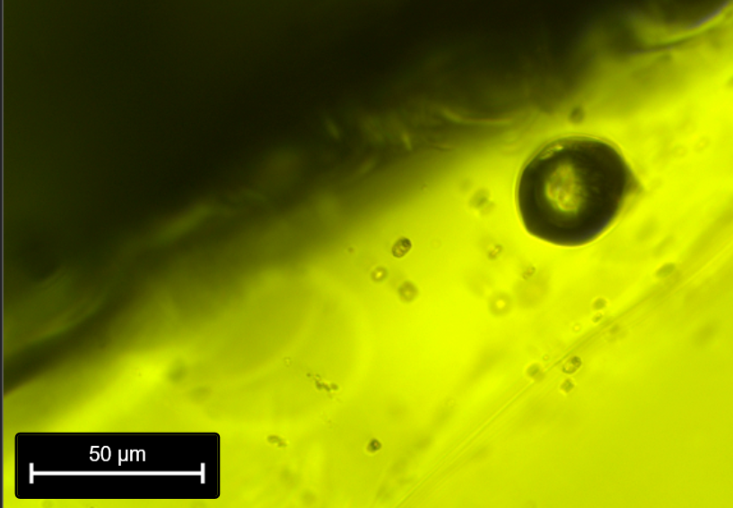
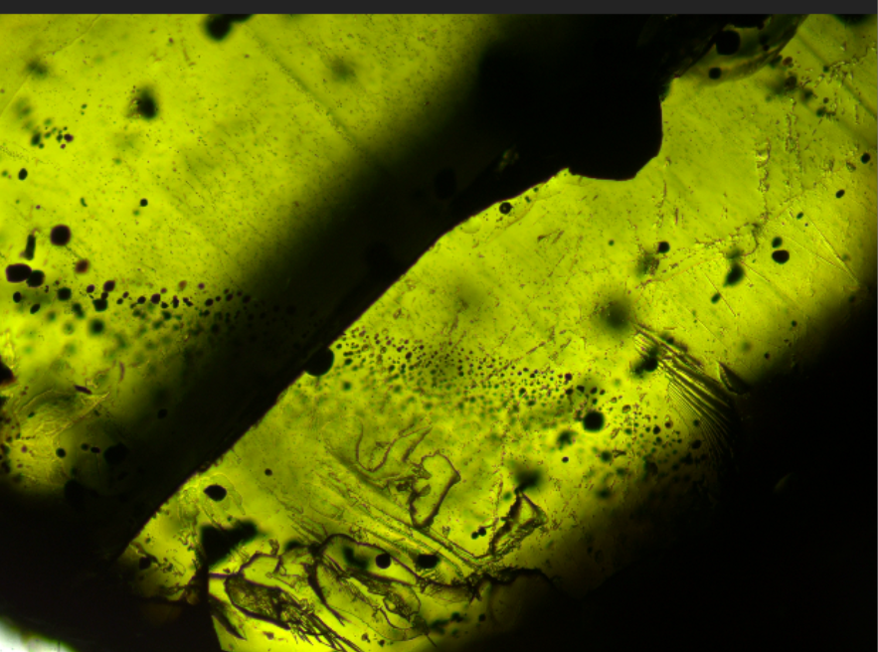
MLP_4_FIA

Slide 8
MLP_4_reg2, reg3
Other points to assess heterogenous
reg2
reg3

Slide 9
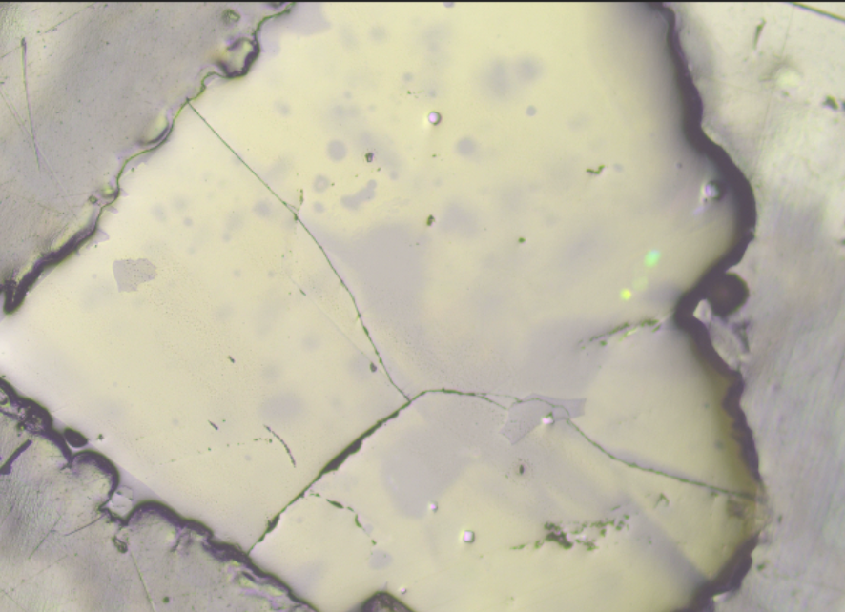
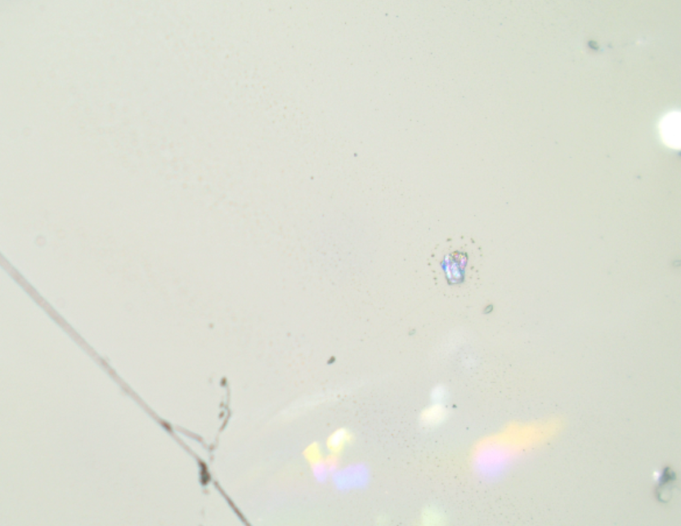
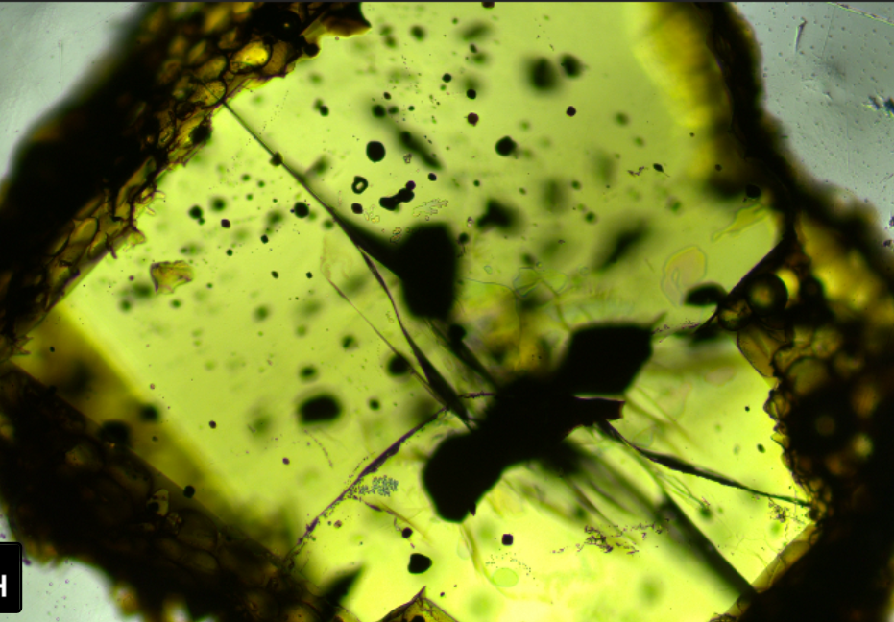
MLP_18_FIA

Slide 10
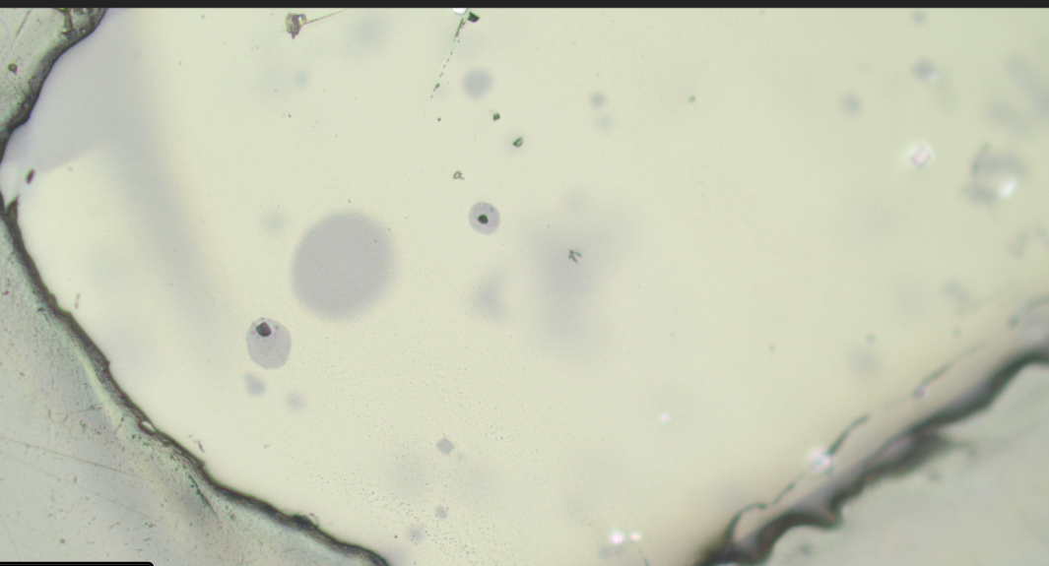
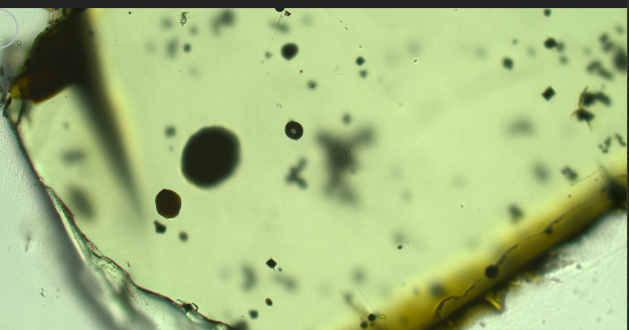
MLP_22_FIA–
PW: Diad too weak

Slide 11
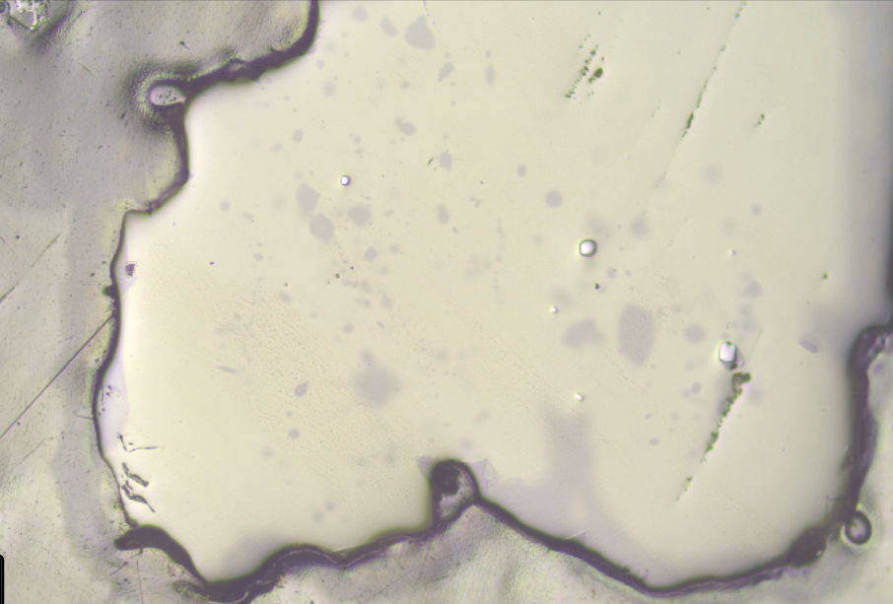
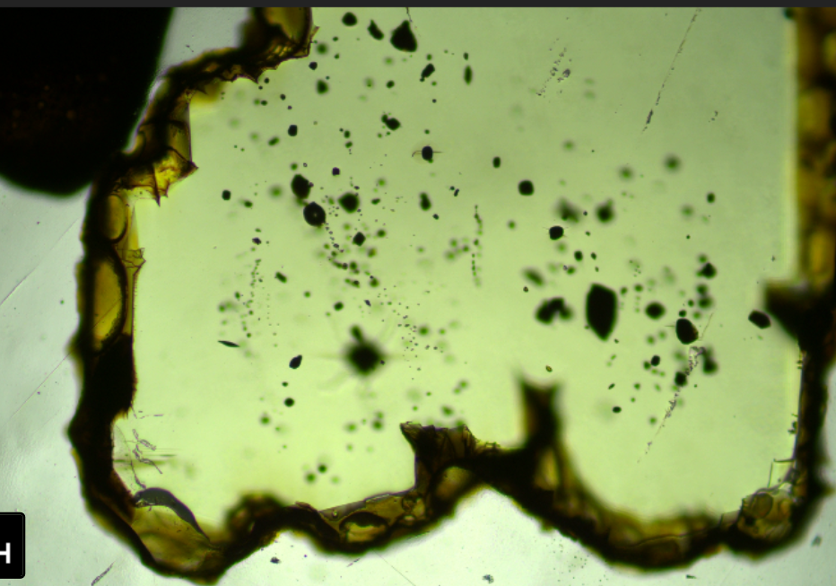
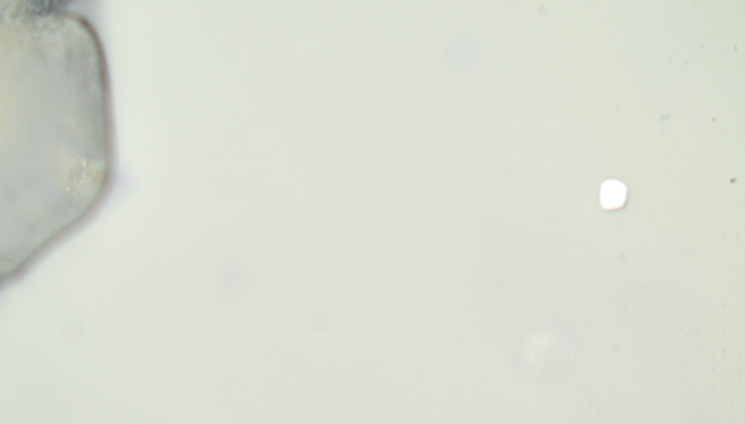
MLP_11_FIA
PW: Has diad, not in my current table….

Slide 12
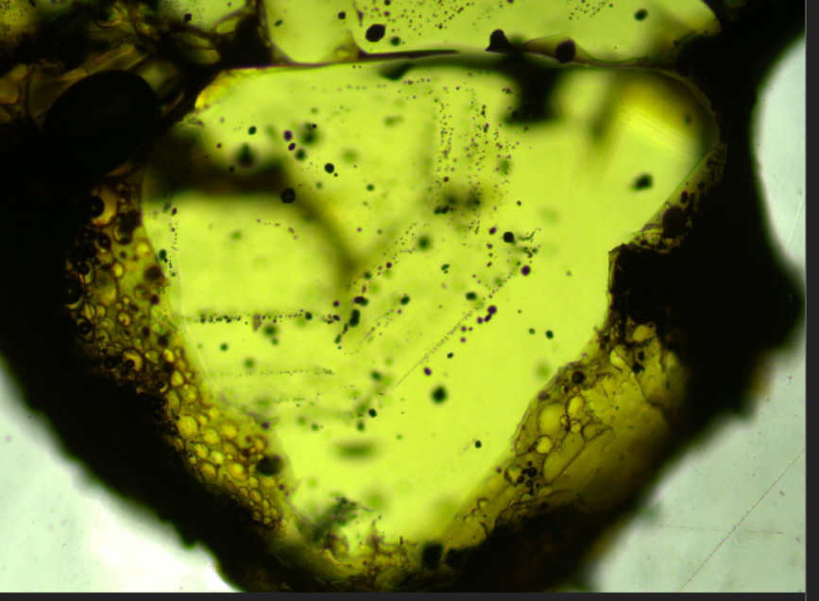
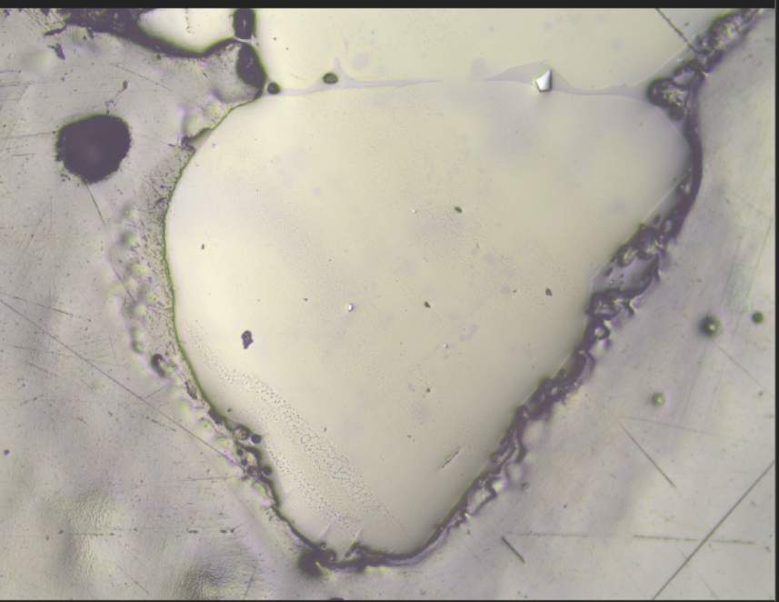
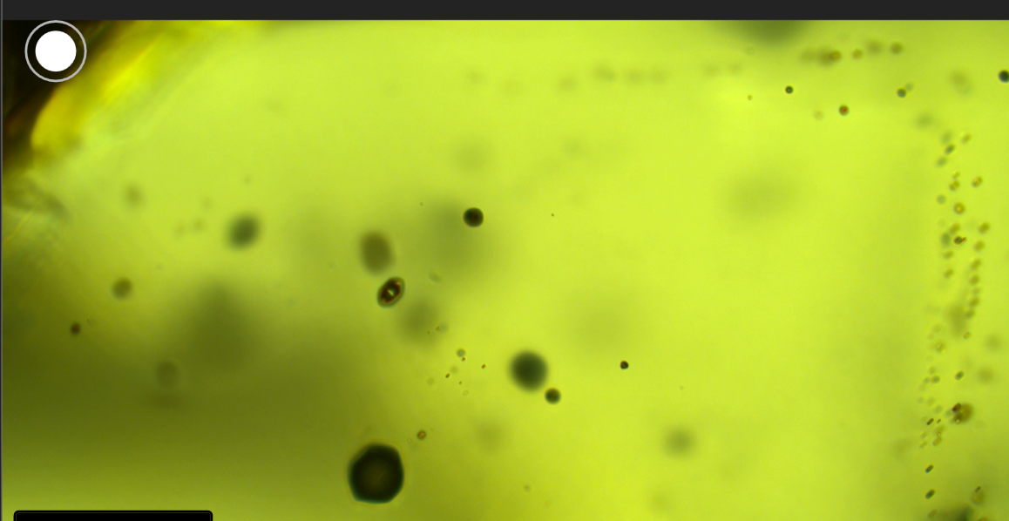
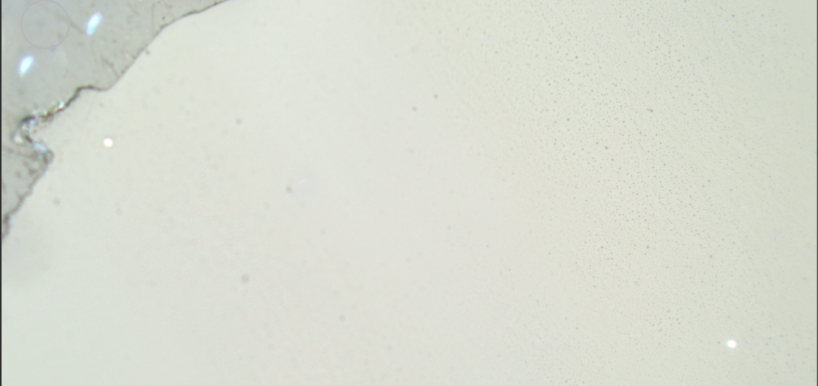
MLP_12_FIA, MLP_12_FIB
MLP_12_FIA
MLP_12_FIB

Slide 13
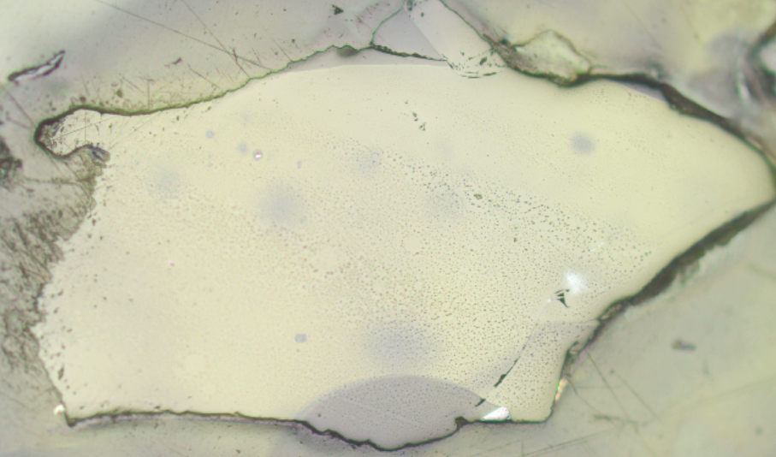
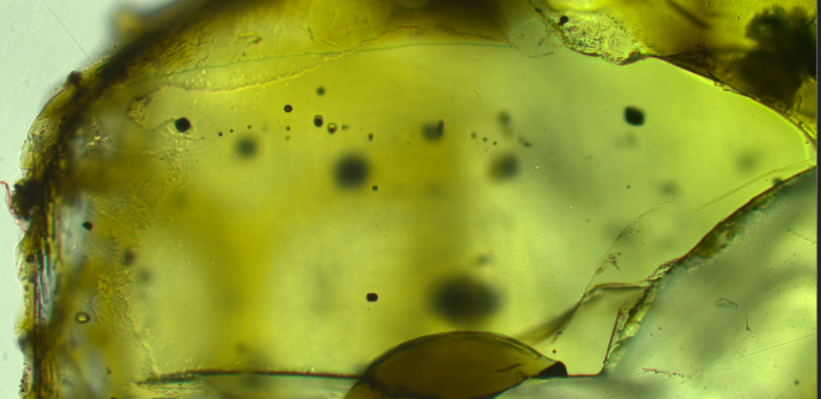
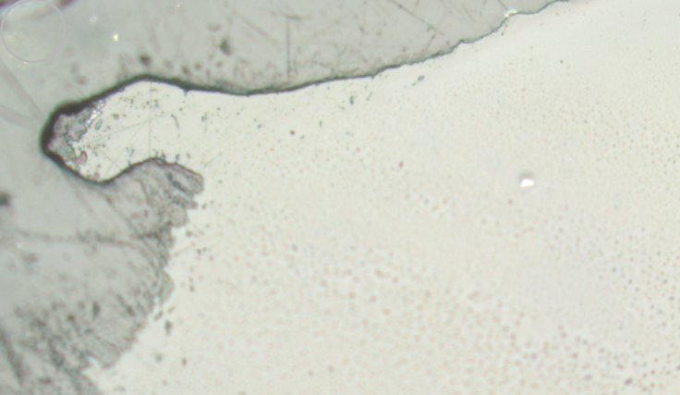
ML22_1_FIA

Slide 14
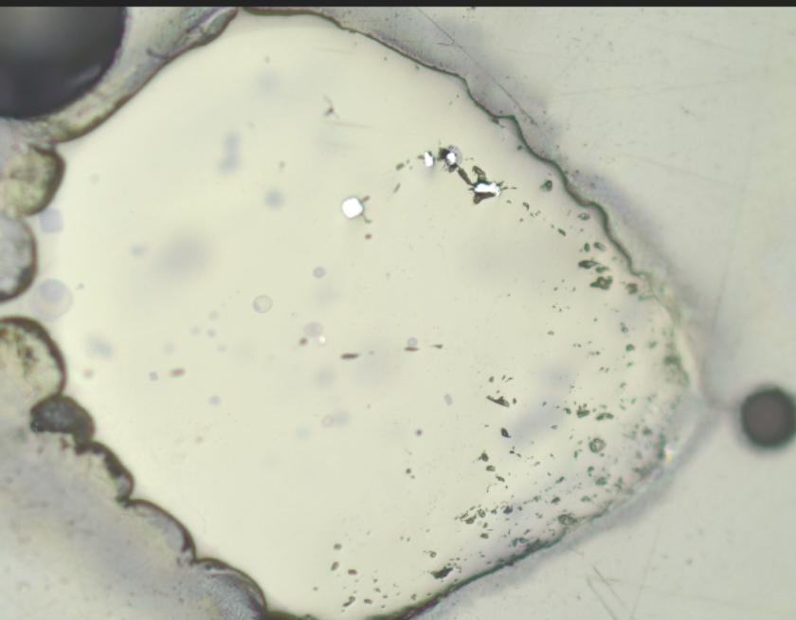
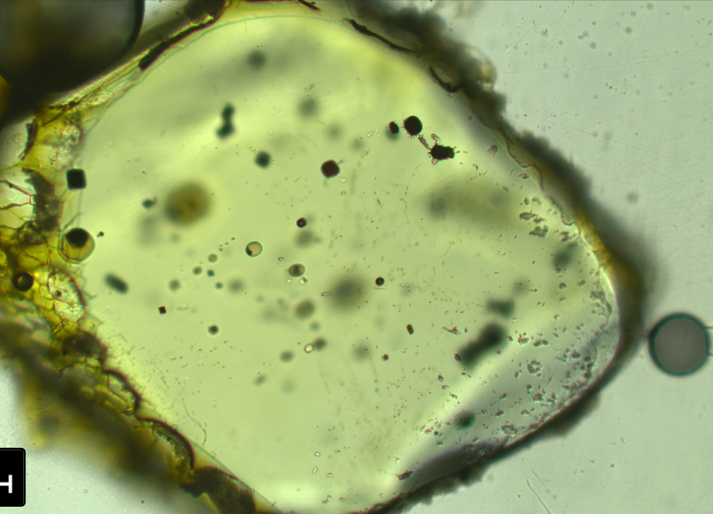
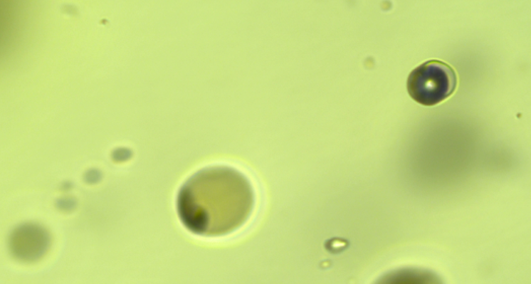
ML22_16_FIA

Slide 15
ML22_16_FIB

Slide 16
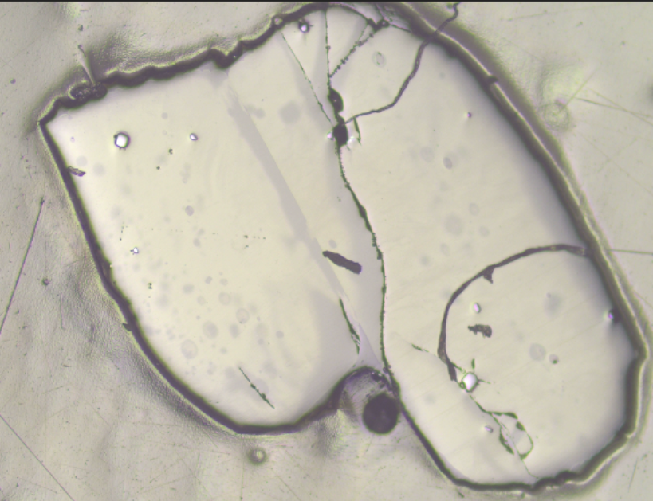
ML22_13
Mounted upsideown. Take a few Fo to check for homogeneity
reg3
reg1
reg2

Slide 17
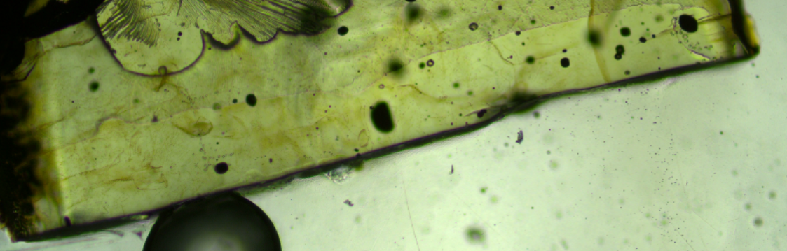
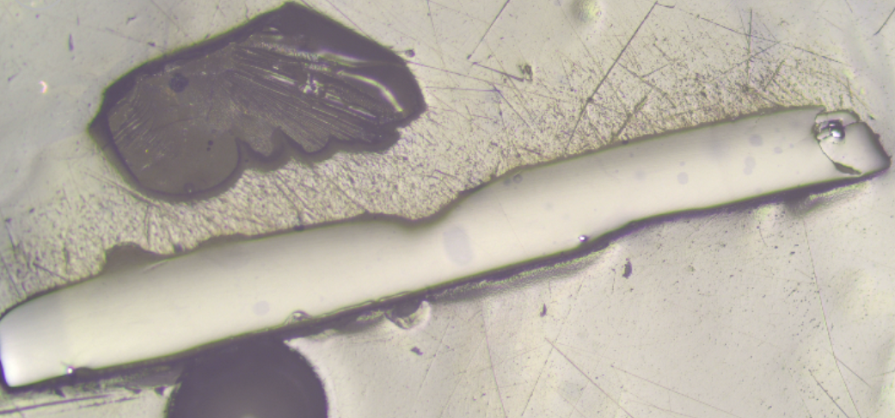
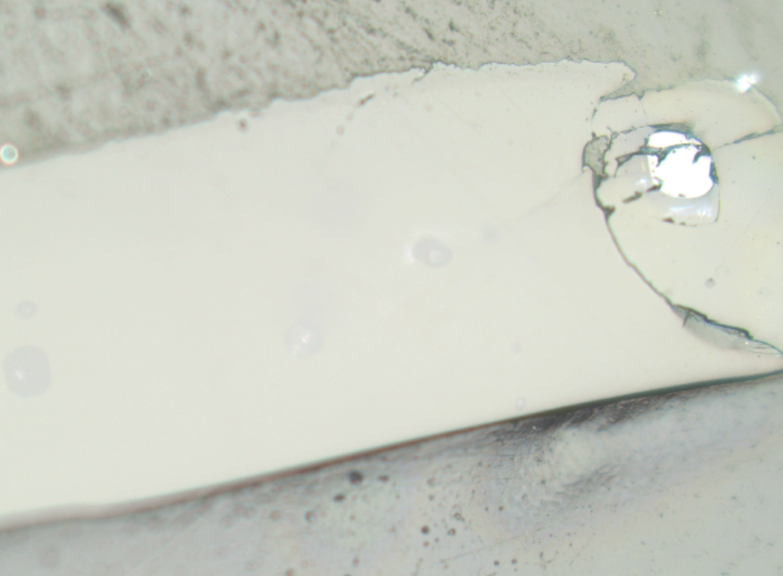
ML22_7_reg1
For PW
A and B
Is also another nice one underneath.
reg1

Slide 18
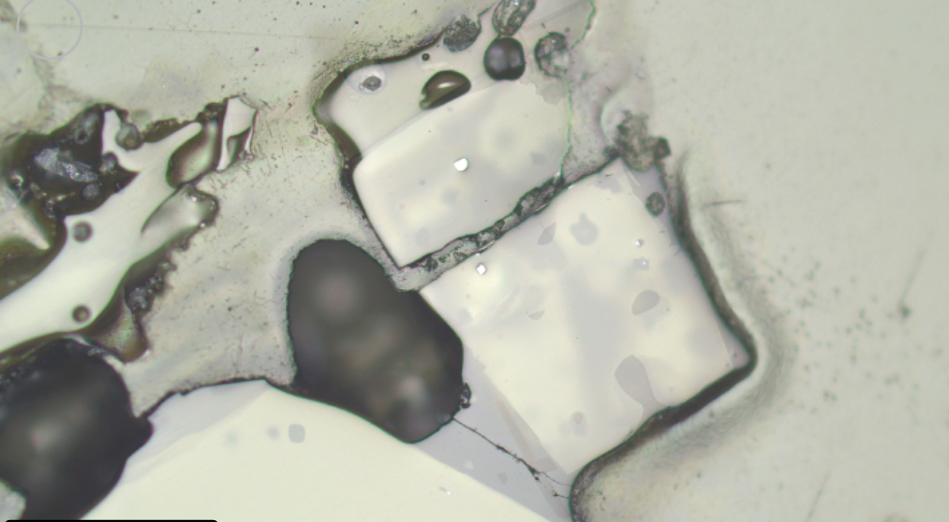
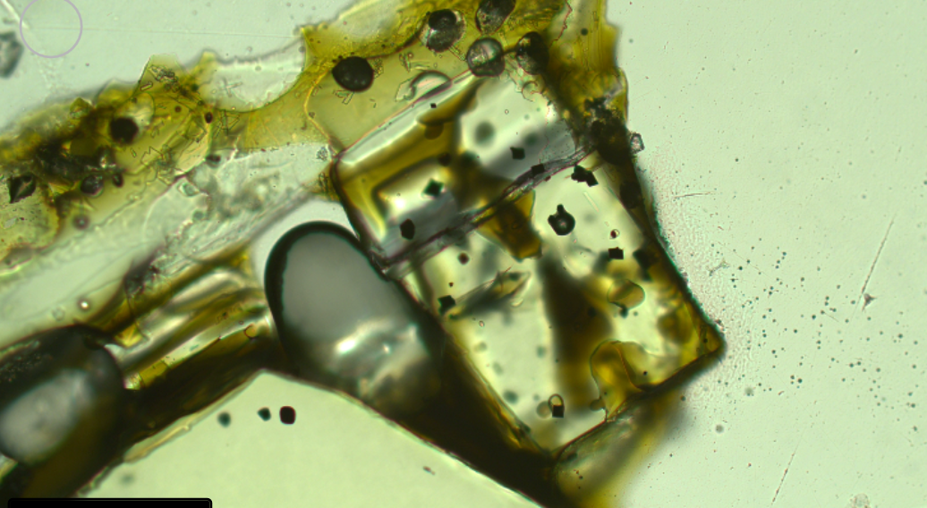
ML22_15_FIA

Slide 19
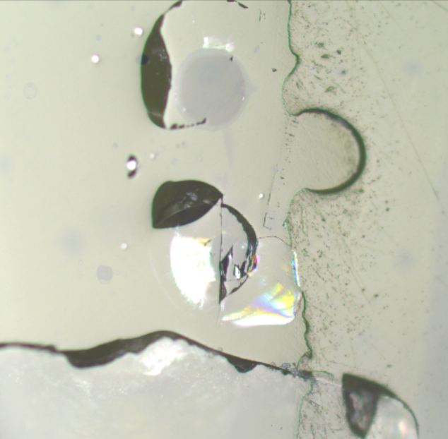
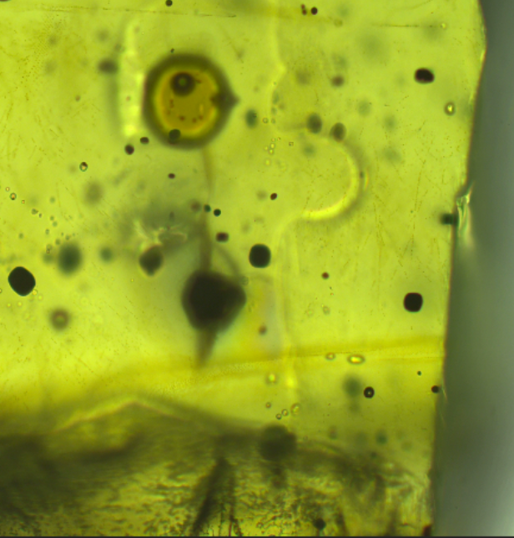
ML22_2_reg1, reg2
PW:FIA and FIB not exposed. For A average r1-r2, B use R2
reg1
reg2

Slide 20
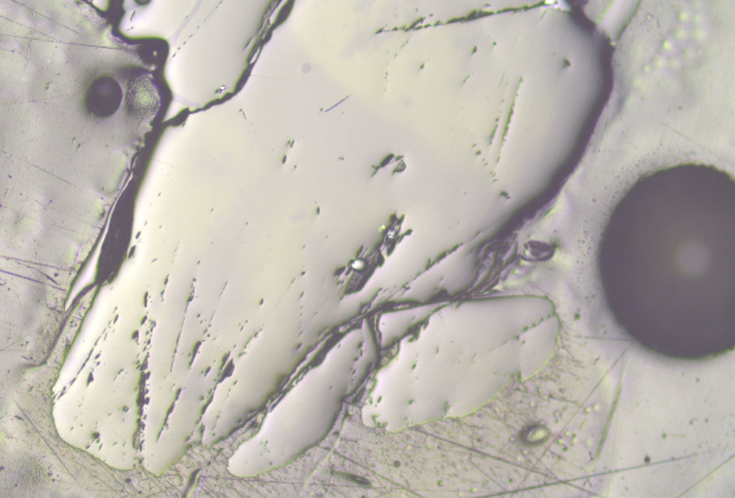
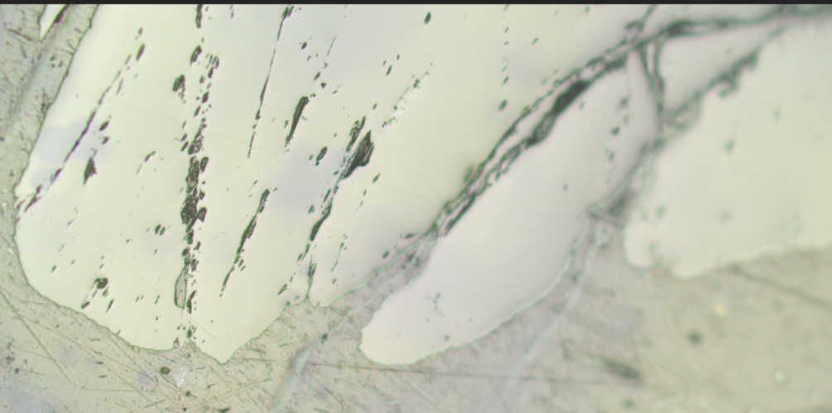
MP2_63_reg1, reg2, reg3
Bit over FI not exposed, do 3 points to get hetereogenity
Reg1 on same zone
reg1
reg2
reg3

Slide 21
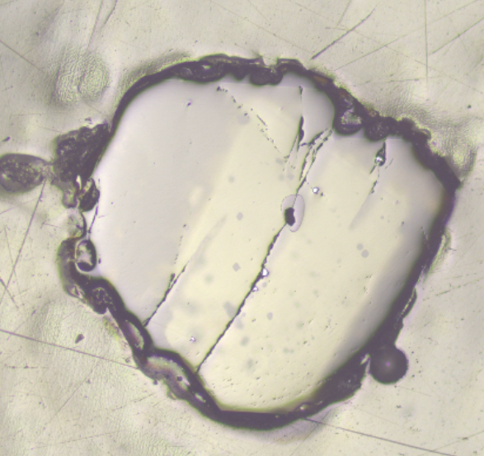
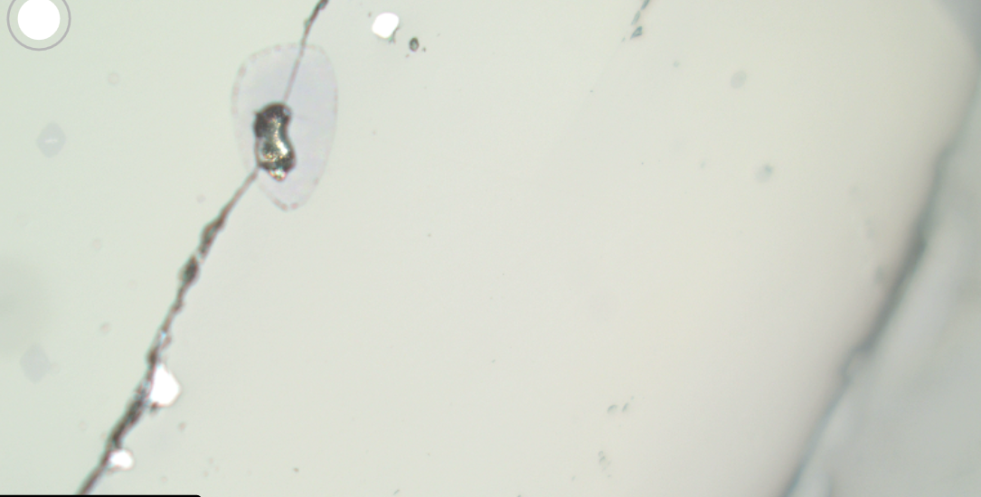
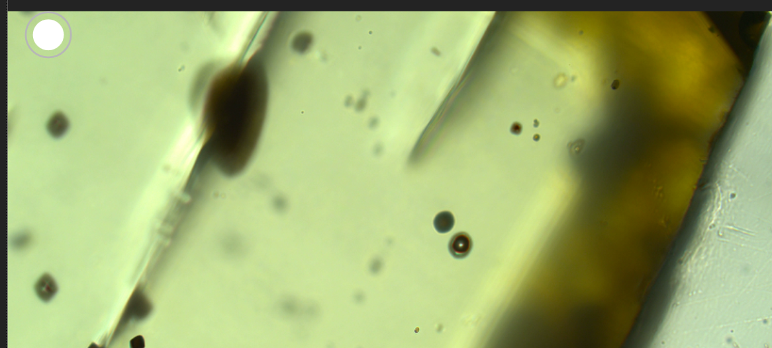
MLP_26_reg1
PW:Reg1 for FIA and FIB
B
A
Notes:
Temp harder to control in epoxy.

Slide 22
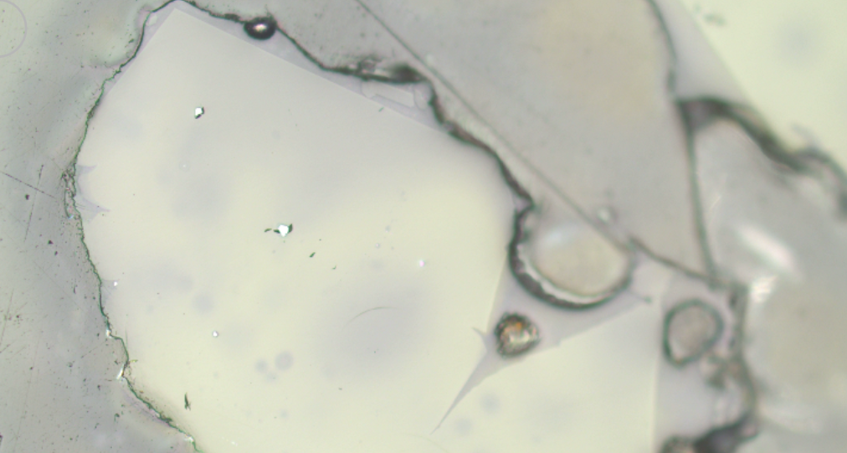
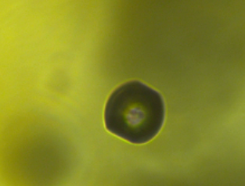


MLP_25_FIA

Slide 23



MLP_25_FIB

Slide 24




MLP_32_FIA
No features in RL except 1 tiny white dot
Xstal broke in 2 fragments

Slide 25



MLP_32_FIB
No features in RL except 1 tiny white dot
Xstal broke in 2 fragments

Slide 26




MLP_33_FIA

Slide 27




MLP_33_reg3
PW: FIB-C
FIB
FIC
Notes:
C very weak, quite deep, had to use 100X

Slide 28




MLP_34 don’t probe!
_FIA – no diads in any of them
Notes:
Has clear pyroxene peak. No diads

Slide 29



MLP_34 don’t probe!
FIB, C, D
C
B
D

Slide 30




MLP_37_FIA
Possible sulf on bubble?

Slide 31




MLP_44_FIA

Slide 32



MLP_43_FIA

Slide 33



MLP_42_dontprobe xstal, no real CO2.
reg1, reg2
FIA-E?
reg2
reg1

Slide 34



MLP_41_FIA

Slide 35



MLP_40_reg1
FIA and FIB
FIB
FIA

Slide 36





MLP_39_reg1
FIA FIB
FIB
FIA

Slide 37



MLP_39_FIC

Slide 38




MLP_46_FIA
Got scratched to shit on raman. Do you rbest. Its just at the top of the big scratched area.

Slide 39



MLP_47_FIA

Slide 40

MLP_47_FIB

Slide 41

MLP_47_FIC
PW: Also FID
C
D

Slide 42




MLP_48_FIA

Slide 43

MLP_48_FIB

Slide 44
MLP_48_FIB

Slide 45

MLP_48_FIC

Slide 46



MLP_49_FIA

Slide 47

MLP_49_FIB

Slide 48



MLP_50_FIA

Slide 49


MLP_50_FIB

Slide 50


MLP_50_FIC

